Slide 1
I/O operation Techniques
Three techniques are possible for I/O operations
  Programmed I/O
  Interrupt driven I/O
  Direct Memory Access(DMA)

Slide 2

They are the result of IO instructions written in the computer program.
Each data item transfer is initiated by an instruction in the program.
Transferring data under program control requires constant monitoring of the peripheral by the CPU.
Once a data transfer is initiated, the CPU is required to monitor the interface to see when a transfer can again be made
Disadvantage: The CPU is wasting time while checking the flag instead of doing some other useful processing task.

Slide 3


I/O Interface
I /O bus
Data bus
Read status register
Data register
Check flag bit
Address bus
Data valid
I/O device
= 0
Flag
= 1
C P U
I /O read
Read data register
I/ O write
Status register
F
Data accepted
Transfer data to memory
Operation complete ?
no
yes
F = Flag bit
Continue with program

Slide 4
Overview of Programmed I/O
When the processor is executing a program and encounters an instruction relating to I/O, it executes that instruction by issuing a command to the appropriate I/O module.
With programmed I/O, the I/O module will perform the requested action and then set the appropriate bits in the I/O status register
The I/O module takes no further action to alert the processor, it does not interrupt the processor.
Thus, it is the responsibility of the processor periodically to check the status of the I/O module until it finds that the operation is complete.

Slide 5
I/O Commands
To execute an I/O-related instruction, the processor issues an address, specifying the particular I/O module and external device, and an I/O command.
There are four types of I/O commands that an I/O module may receive when it is addressed by a processor
Control
Test
Read
Write

Slide 6
I/O Commands
Control: Used to activate a peripheral and tell it what to do.
For example, a magnetic-tape unit may be instructed to rewind or to move forward one record.
Test: Used to test various status conditions associated with an I/O module and its peripherals.
The processor will want to know that the peripheral of interest is powered on and available for use.
It will also want to know if the most recent I/O operation is completed and if any errors occurred

Slide 7
Read: Causes the I/O module to obtain an item of data from the peripheral and place it in an internal buffer
The processor can then obtain the data item by requesting that the I/O module place it on the data bus.
Write: Causes the I/O module to take an item of data (byte or word) from the data bus and subsequently transmit that data item to the peripheral.

Slide 8
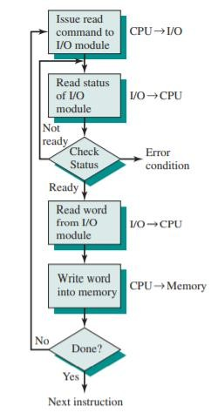
Data are read in one word (e.g., 16 bits) at a time.
For each word that is read in, the processor must remain in a status-checking cycle until it determines that the word is available in the I/O module’s data register.
Disadvantage : it is a time-consuming process that keeps the processor busy needlessly.

Slide 9
I/O Instructions
There will be many I/O devices connected through I/O modules to the system.
Each device is given a unique identifier or address.
When the processor issues an I/O command, the command contains the address of the desired device.
Thus, each I/O module must interpret the address lines to determine if the command is for itself.
When the processor, main memory, and I/O share a common bus, two modes of addressing are possible: memory mapped and isolated

